Slide 1
STOCK MARKET ANALYSIS
Submitted By: Vansh Gupta
Roll No.: 2020UEA6576
Submitted To: Prof. Rashmi Gupta
Deep Learning Project

Slide 2
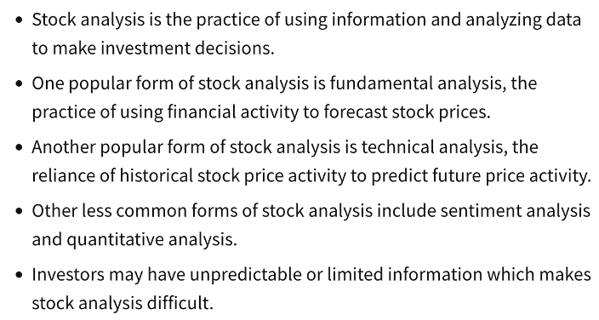
Introduction

Slide 3
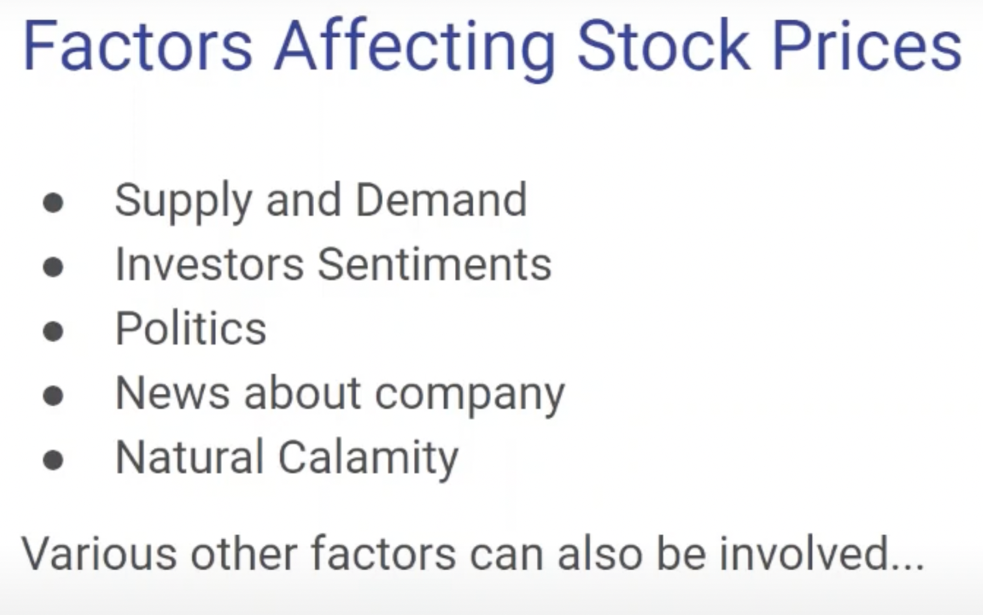

Slide 4
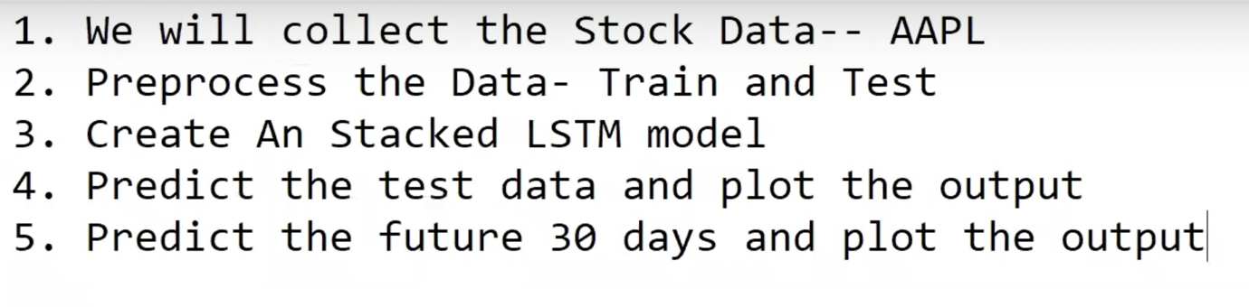
STEPS INVLOVED

Slide 5
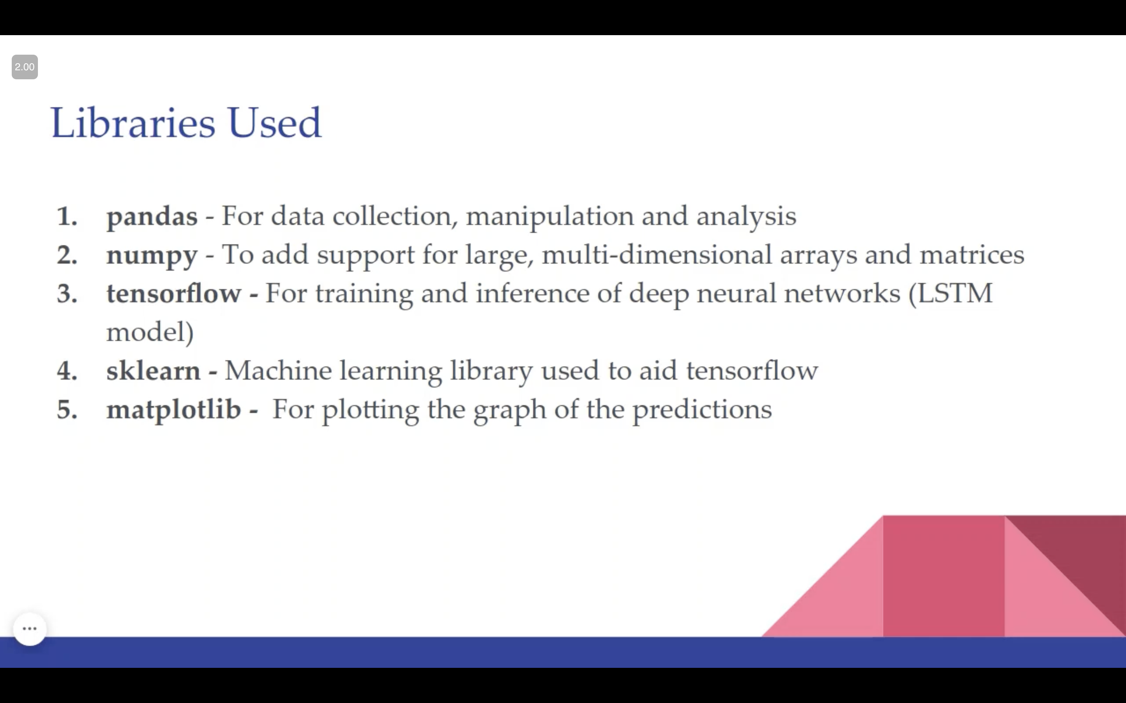

Slide 6
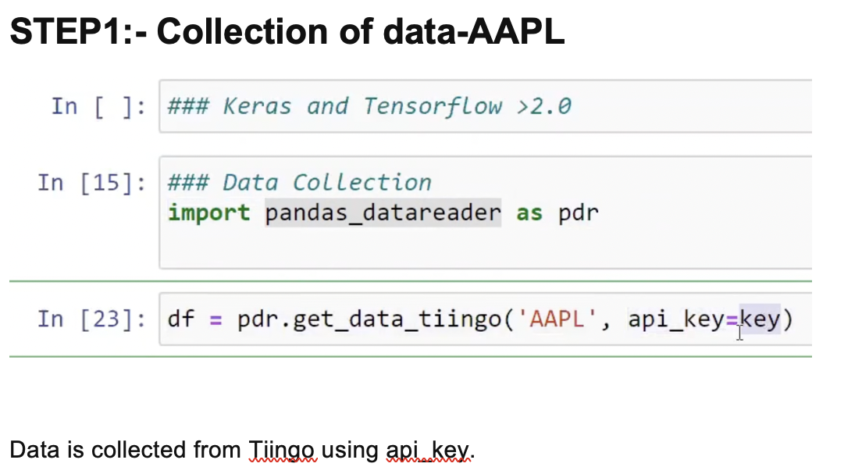

Slide 7
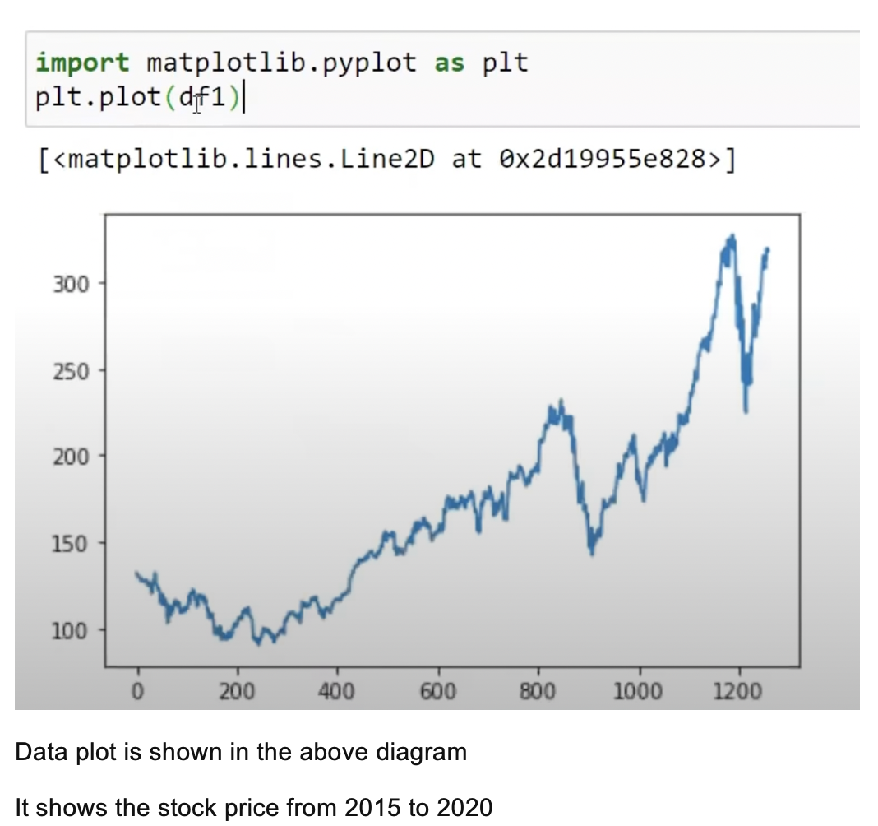

Slide 8
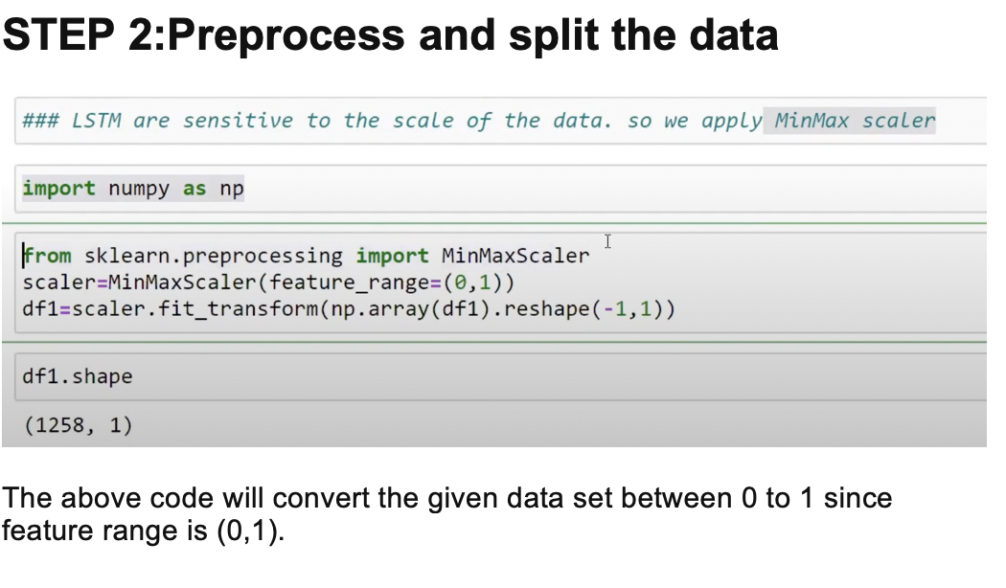

Slide 9
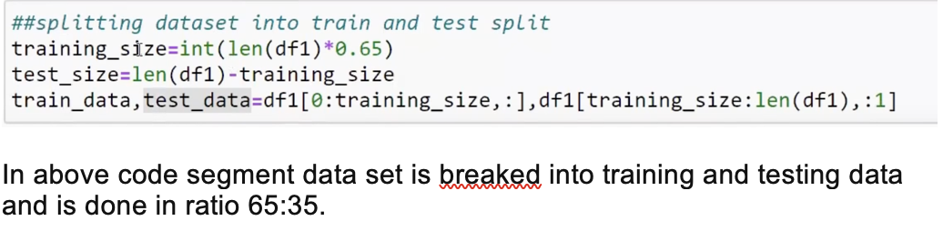
SPLITING INPUT DATA INTO TESTING AND TRAINING DATA

Slide 10
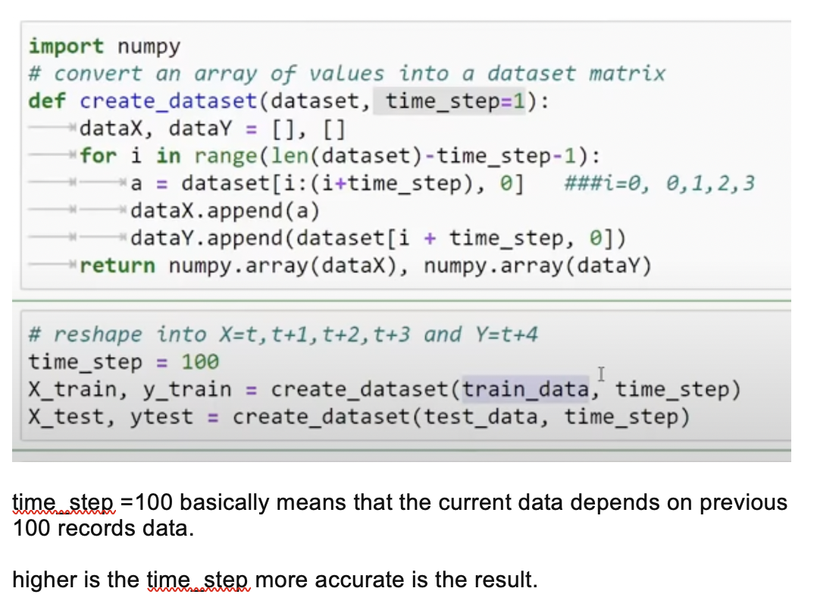
Taking previous 100 dataset to get next output

Slide 11
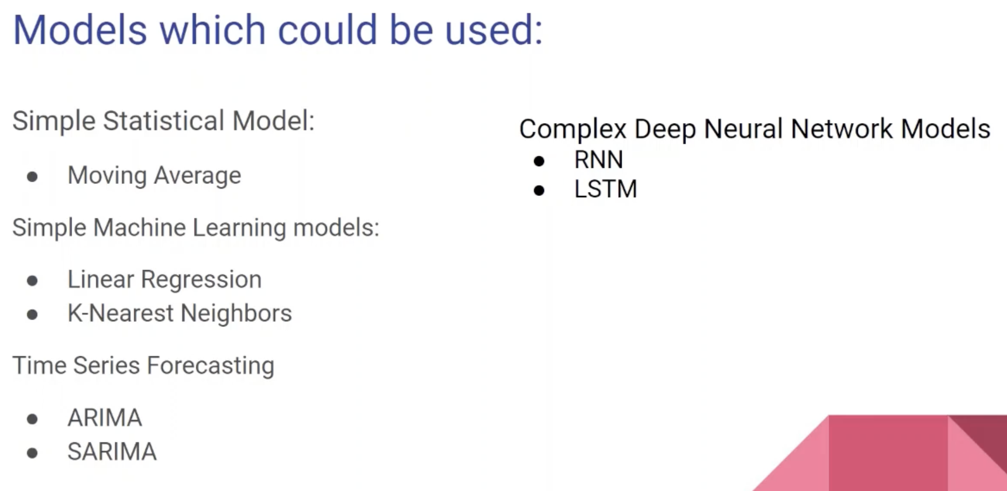

Slide 12
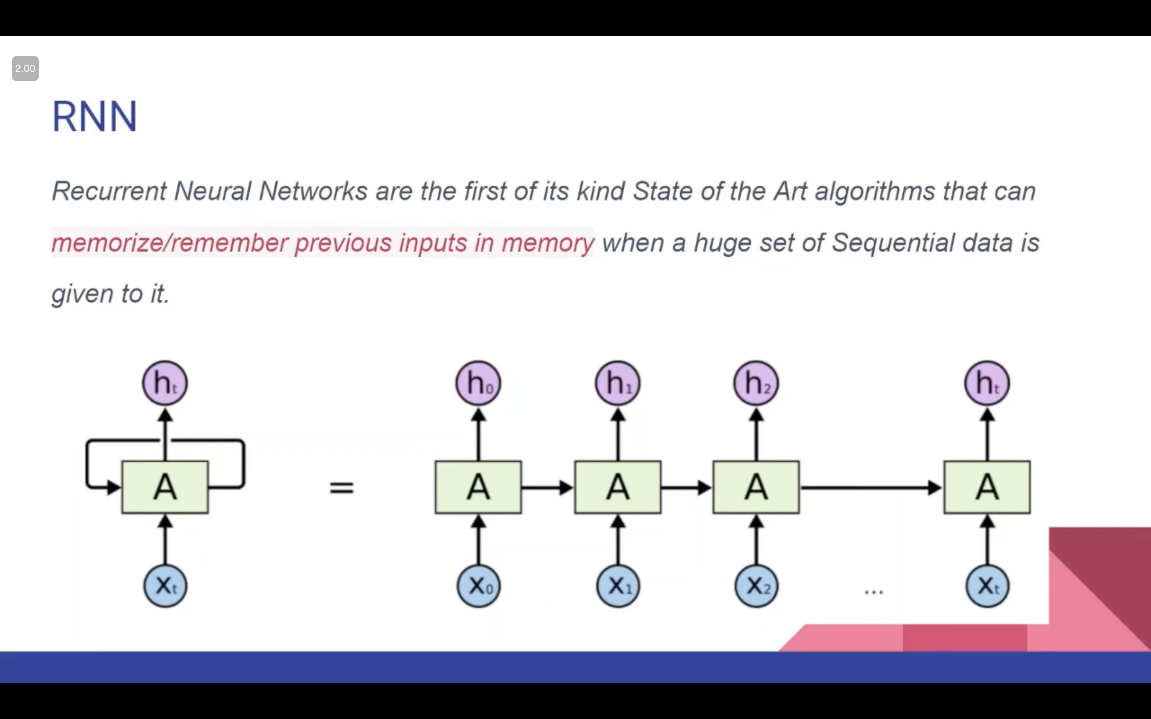

Slide 13
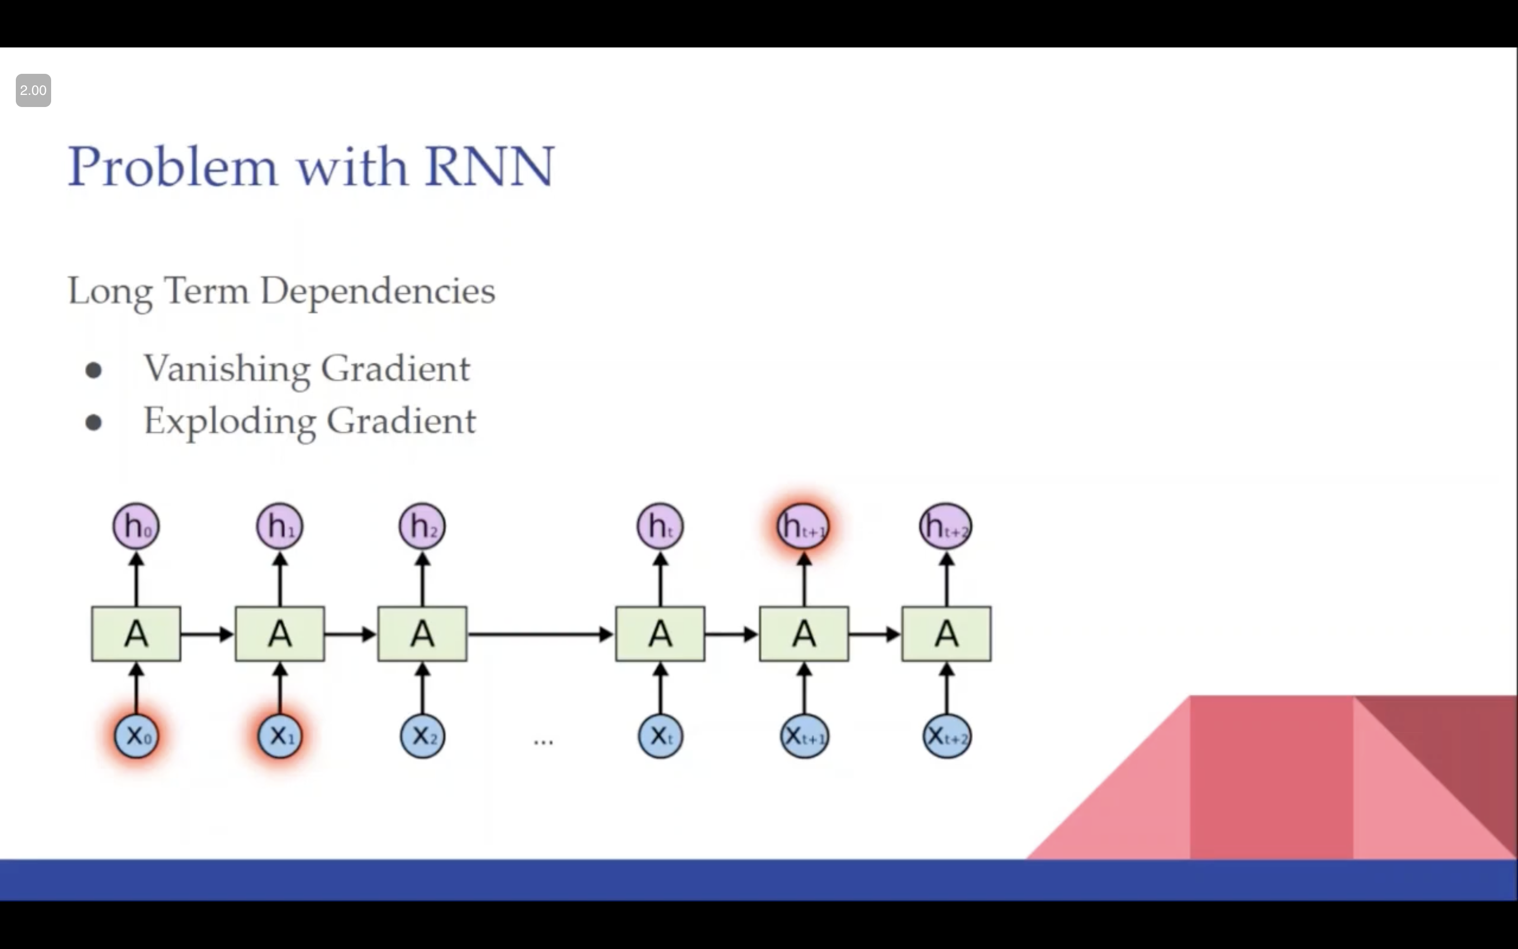

Slide 14
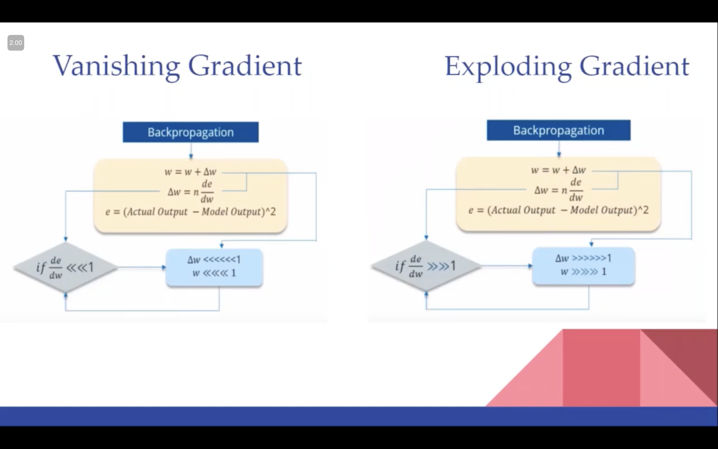

Slide 15
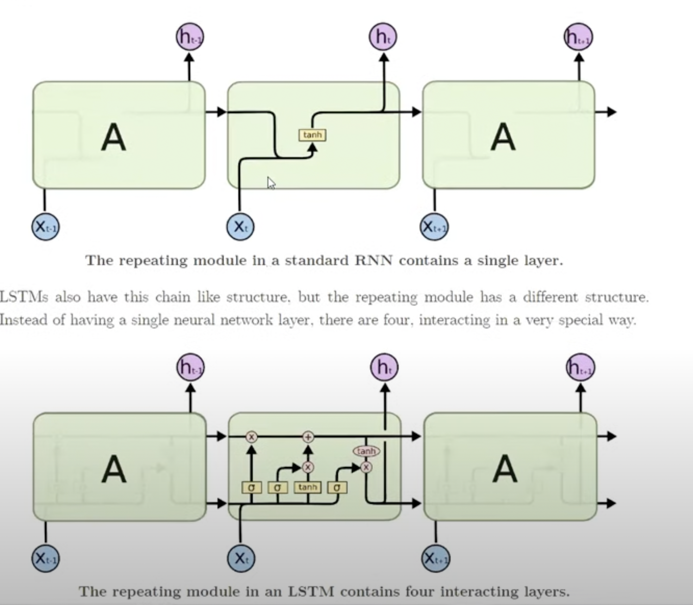
WHY LONG STORT TERM MEMORY

Slide 16
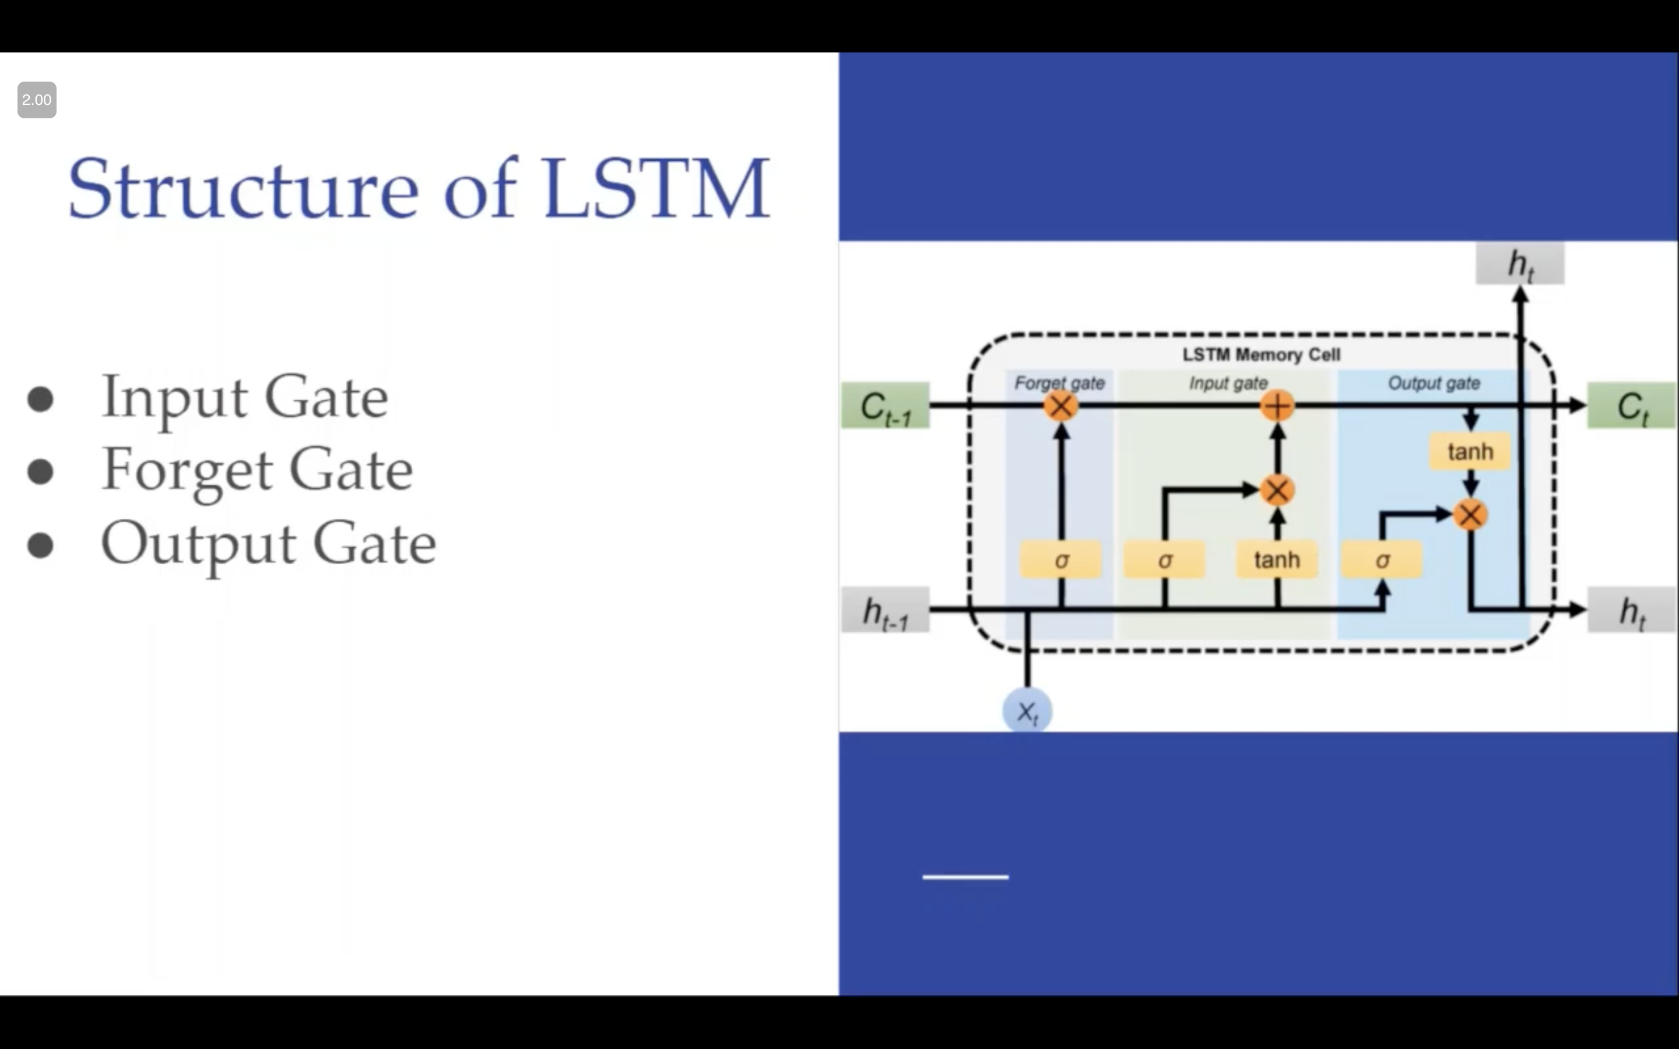

Slide 17
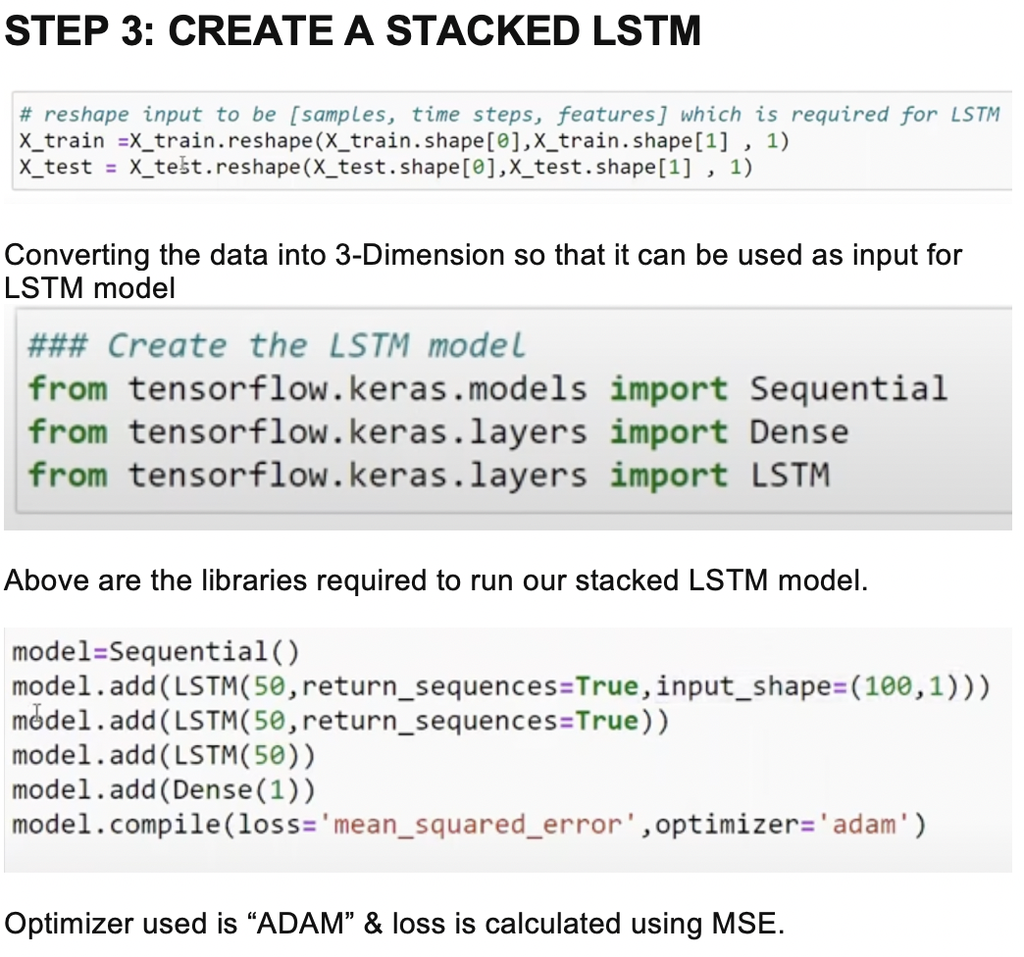

Slide 18
Optimizer Used
The Adam optimizer is a popular choice for optimizing the stock . Adam stands for "Adaptive Moment Estimation", and is a variant of stochastic gradient descent (SGD) that dynamically adjusts the learning rate for each parameter based on the estimated first and second moments of the gradients.
The Adam optimizer works by maintaining a running average of the first and second moments of the gradient. The running average is updated at each iteration of the optimization algorithm, and is used to adjust the learning rate for each parameter in the network. The learning rate is scaled by the ratio of the square root of the second moment to the first moment.

Slide 19
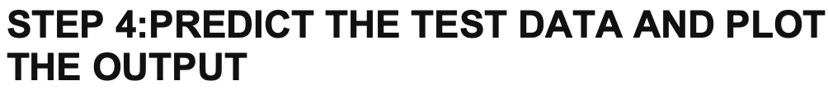
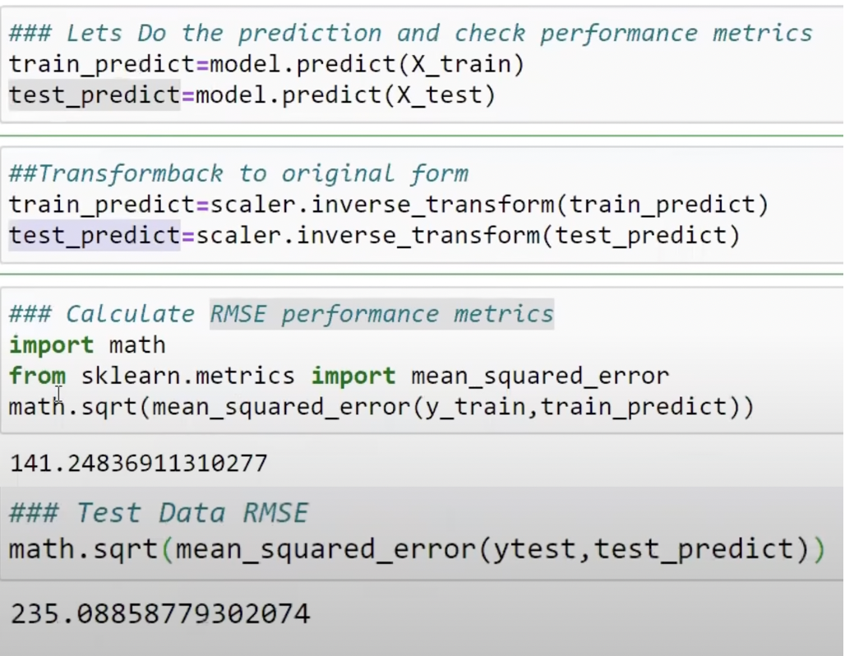

Slide 20
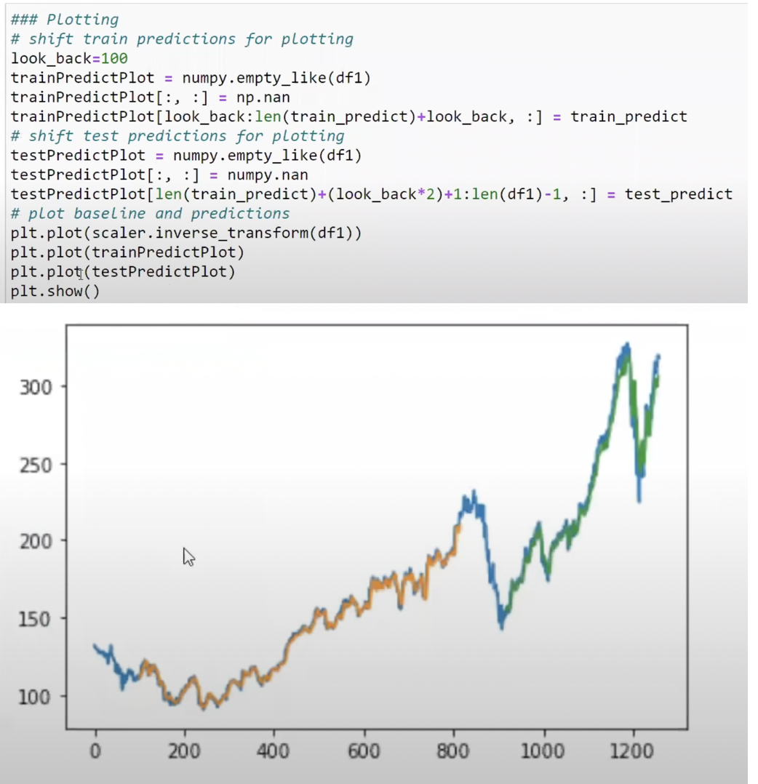

Slide 21
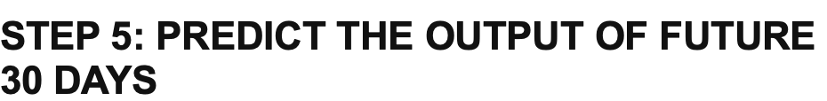
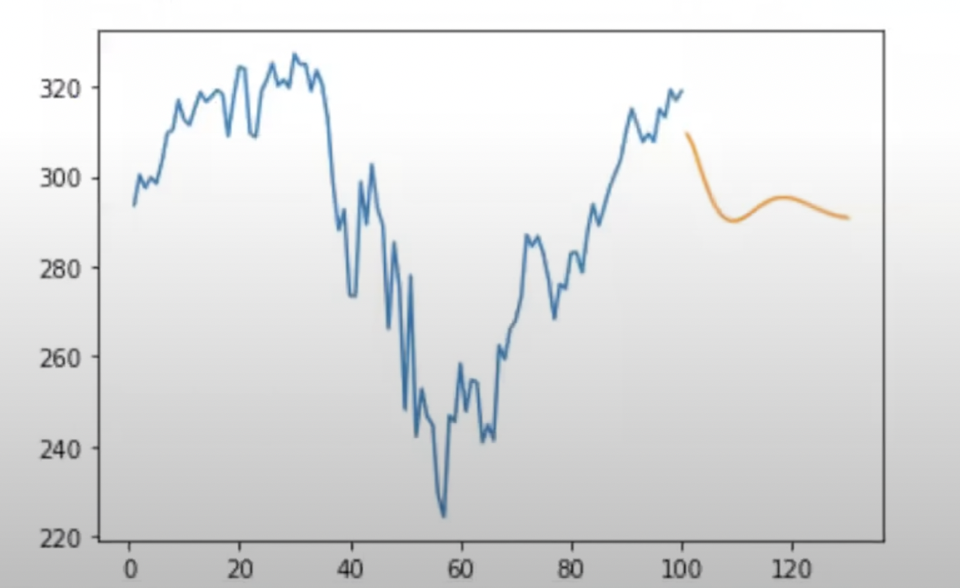
Orange curve shows the predicted output for next 30 days

Slide 22
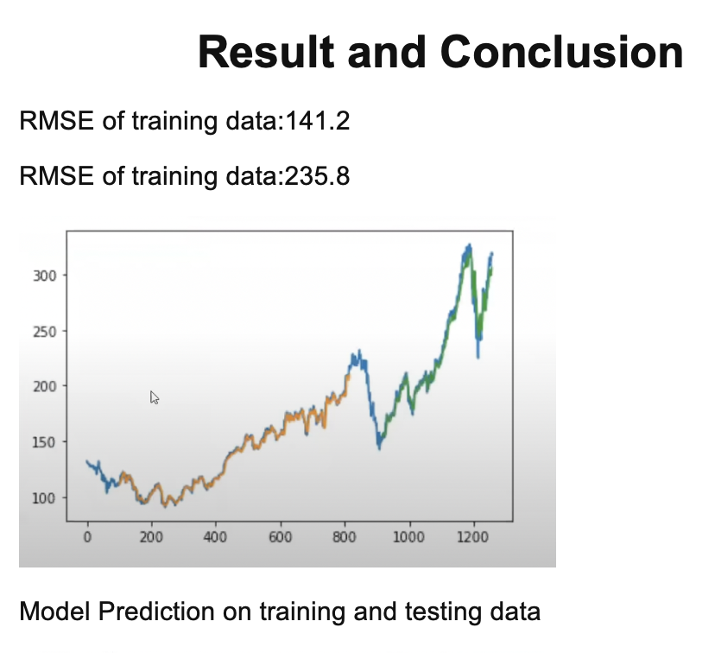

Slide 23
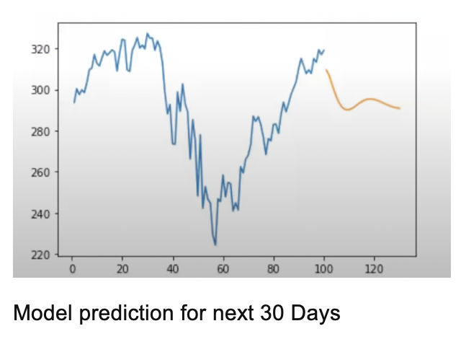
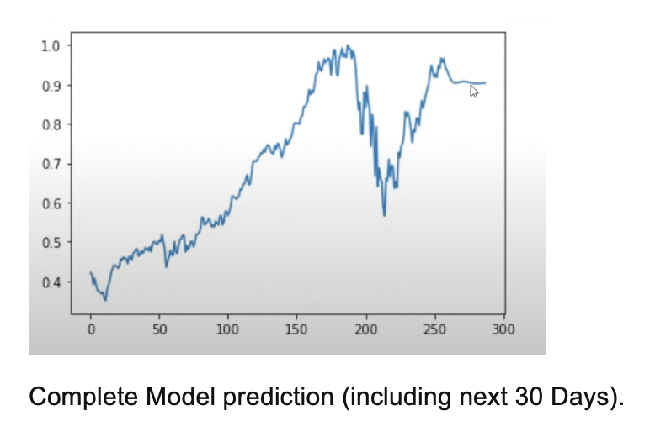
LINK TO GITHUB REPOSITORY
https://github.com/vanshgupta434/STOCK-ANALYSIS-1

Slide 24
Thank You

